Slide 1
Automation Test PlugIn
PRESENTATION

Slide 2
Agenda
Introduction
Previous Version – How it Work
Current Version – How it Works
How to use modified actions ?
Conclusion

Slide 3
Introduction
The Automation Test Plugin is designed to expedite the automation testing process by automatically generating Excel sheets based on user actions performed within a web application. By capturing real user interactions and converting them into structured test steps, the plugin helps save time and effort, reducing manual work and improving overall testing efficiency.

Slide 4
Previous Version
23 user actions supported
4 actions captured automatically
19 actions required keyboard shortcuts
Tester had to remember and use multiple shortcut keys
Actions were recorded in Excel after pressing shortcuts
Limitations
High dependency on shortcuts
Limited flexibility during execution

Slide 5
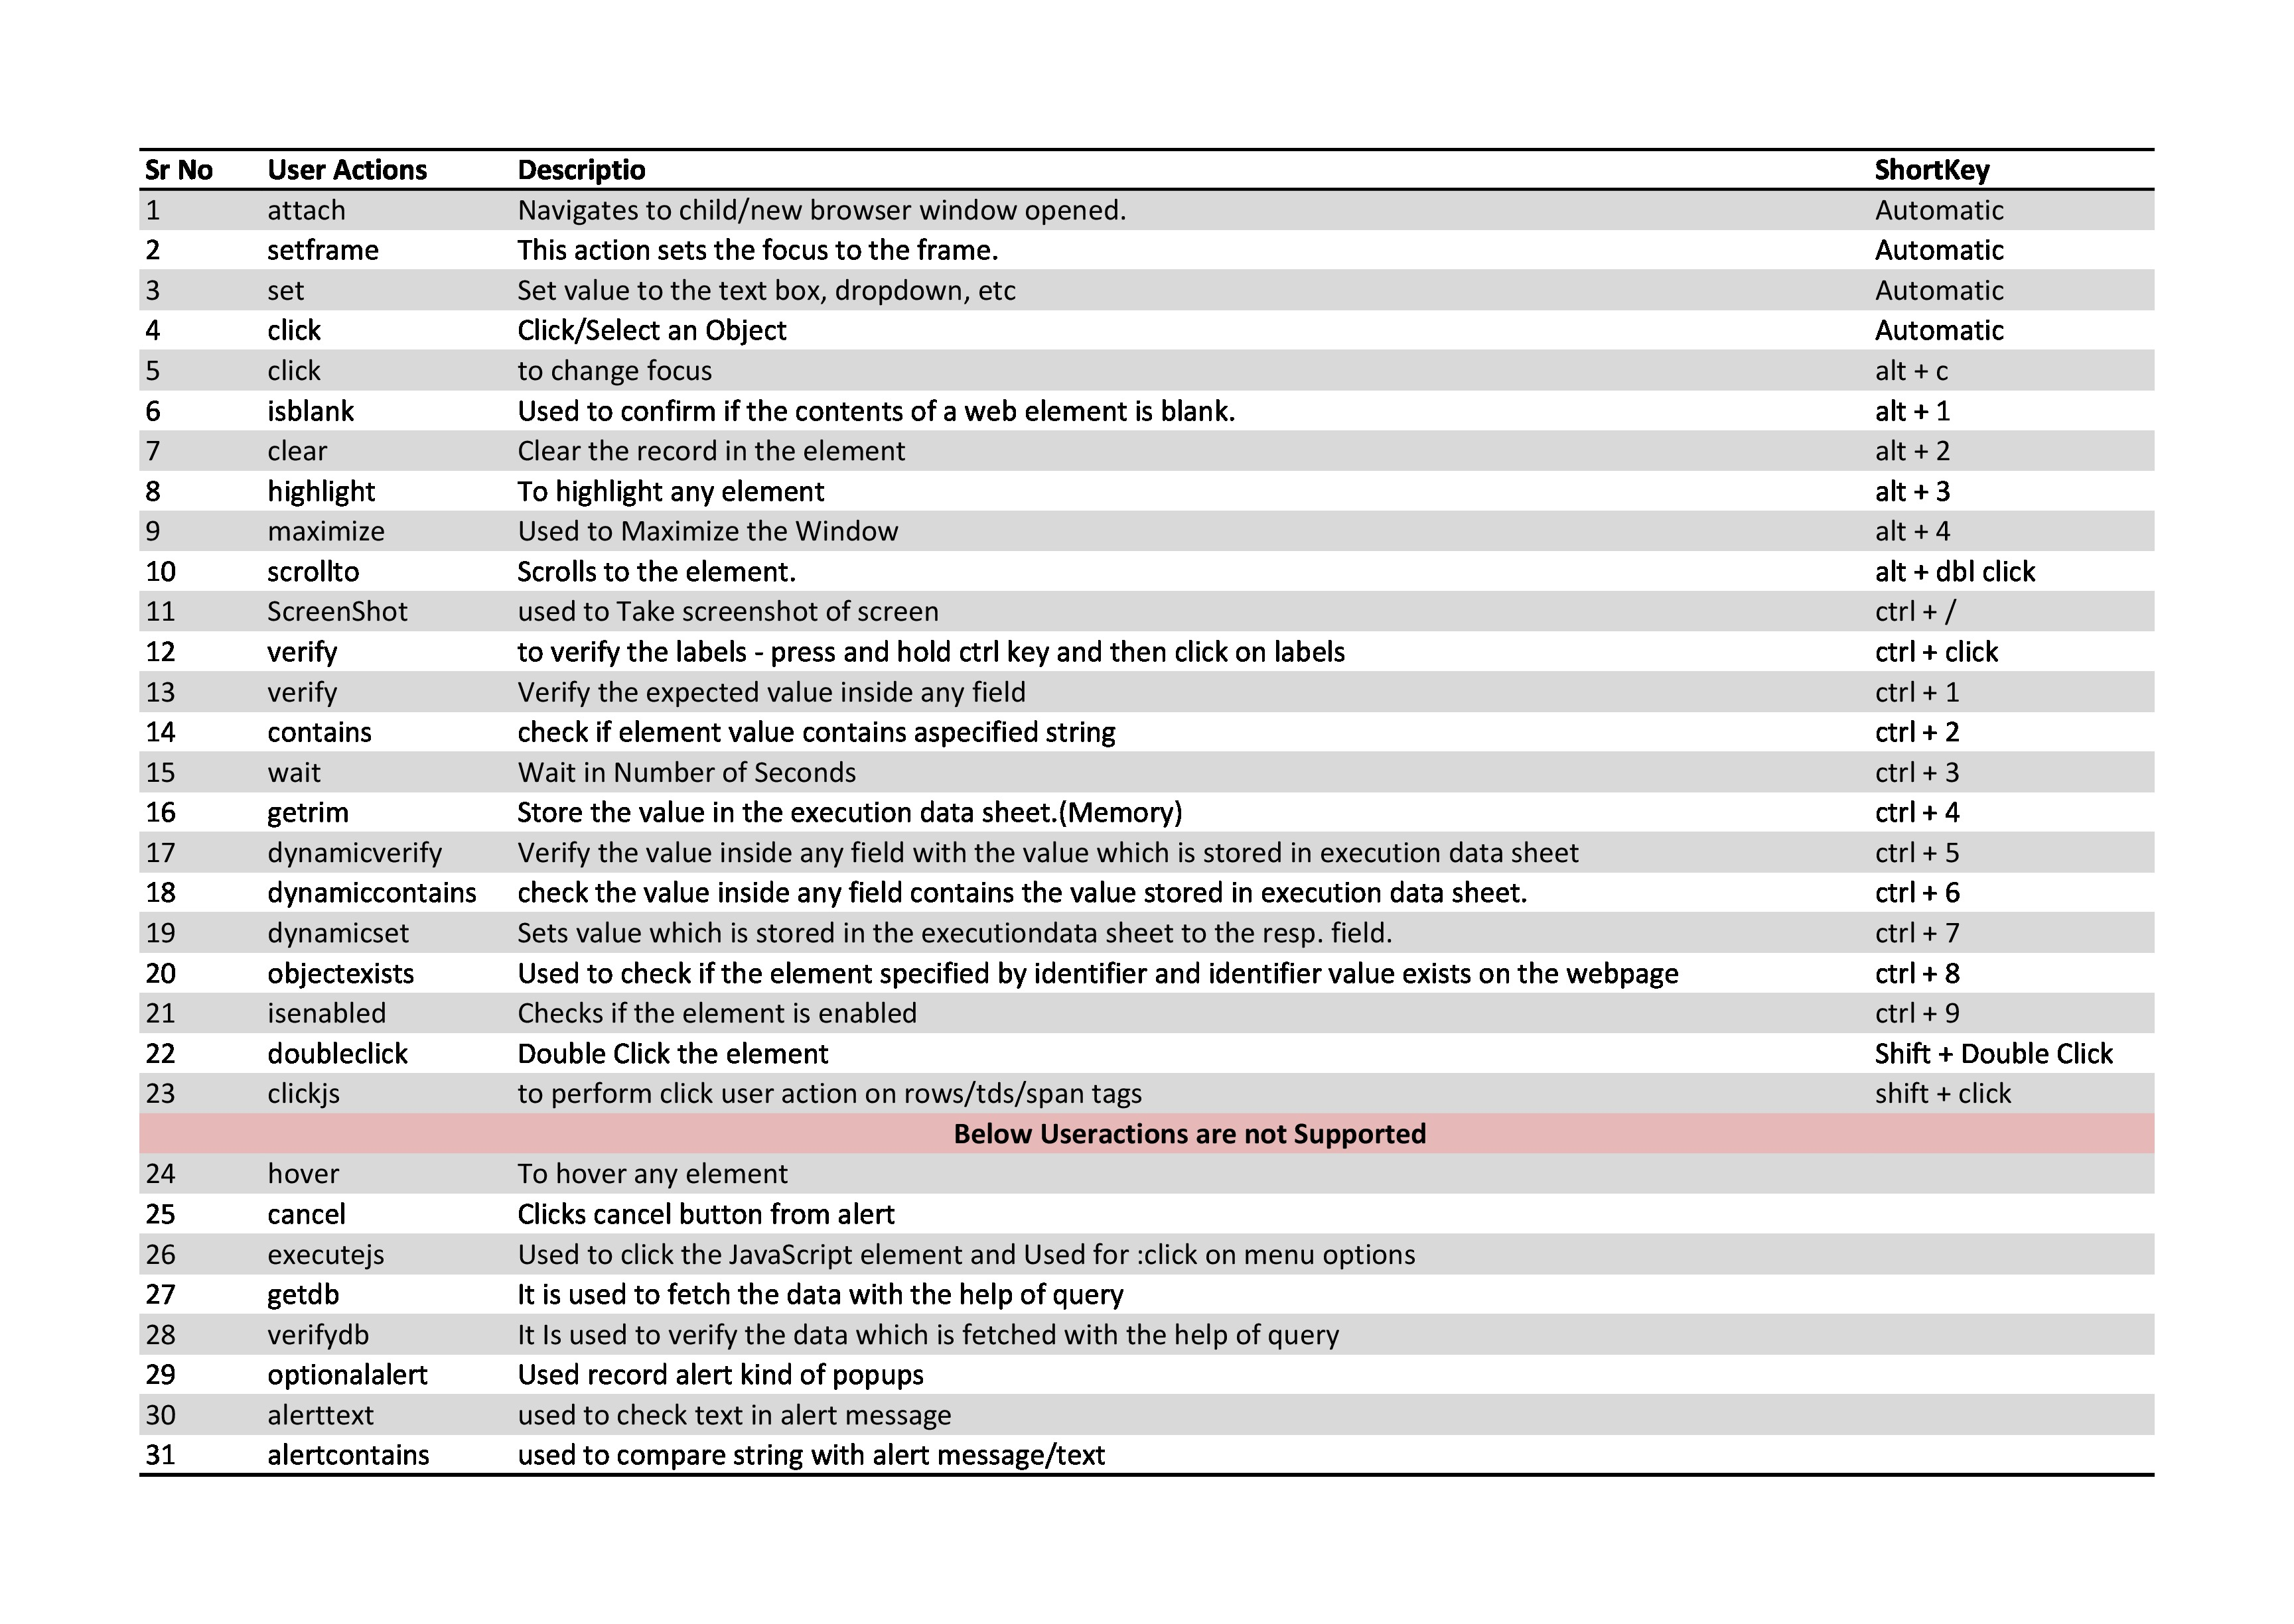

Slide 6
Current Version
Keyboard-shortcut–based recording replaced with an action-driven approach
User actions captured through real user behavior and mouse interactions
Right-click context menu introduced for manual action selection
Actions are captured via:
Right-click → Progno Auto Test Plugin → Select required action
Automatic detection while performing actions
Each action is immediately logged into the Excel sheet with proper details

Slide 7
Modified Actions
Actions Captured by Performing Actions
&
Actions Captured via Right Click Menu

Slide 8
Actions Captured by Performing Actions
User Action Name | Description
Maximize | Maximizing the browser window
Clear | Clearing an existing value from an input field
Screenshot | Taking a screenshot using standard system keys ( fn +f10)
Verify Label | Double-clicking on a label
Verify Value | Double-clicking on a value inside an input field
ClickJS | Normal click action captured via JavaScript
ScrollTo | Scrolling the page
Highlight | Clicking and holding right-click on an element
DoubleClick | By doubleclicking on any element

Slide 9
Actions Captured via Right Click Menu
User Action Name | Description
Click (Change Focus) | Records focus change
Contains | Records whether an element contains a specific value
GetTrim | Records trims text from an element
DynamicVerify | Records Dynamicverifies useraction
DynamicSet | Records Dynamicset useraction
DynamicContains | Records Dynamiccontains useraction
ObjectExists | Records Objectexists useraction
IsEnable | Records isenable useraction
Wait | Records wait action
IsBlank | Record isBlank action

Slide 10
TIPS
When the tester wants to record the following user actions :-
Click (Change Focus), Contains, GetTrim, DynamicVerify, DynamicSet, DynamicContains, ObjectExists, IsEnable, Wait, and IsBlank the action should be recorded using the right-click option.
For Example:
If Tester wants to record the user action for the isblank then tester will right click on the element then select the Progno Auto Test Plugin in that list of user actions , the tester should choose the isblank action and that will record as isblank in Excel Sheet

Slide 11

Conclusion
The updated Automation Test Plugin replaces shortcut-based recording with an action-driven approach that better reflects real user interactions. By introducing right-click context actions and automatic behavior-based recording, the plugin becomes easier to use, more reliable, and more scalable for future enhancements.

Slide 12
THANK YOU

